Slide 1
DSP Problems in Chapter 4

Slide 2
4.3 Solution
4.4 Solution

Slide 3
4.10 Solution

Slide 4
4.12 Solution

Slide 5
4.23 Solution

Slide 6
4.23 Solution

Slide 7
4.30 Solution

Slide 8
4.30 Solution

Slide 9
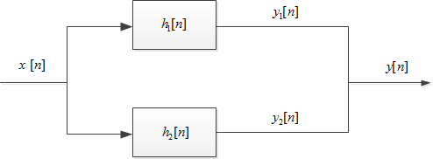
4.35 Solution

Slide 10
4.61 Solution

Slide 11
4.62 Solution

Slide 12
4.69 Solution
We need

